Slide 1

The Patent Cooperation Treaty (PCT)
Update and selected topics of particular interest for paralegals
Dutch Platform for Formalities Officers – Annual Conference
Eindhoven, April 18, 2023
Eva Schumm, Senior Legal Officer,
PCT Legal and User Support Section, WIPO
eva.schumm@wipo.int
+41 22 338 9393

Slide 2
Contents
Review of the PCT procedure and time limits
PCT Timeline
Priority claims and priority documents
"PCT Direct“
Declarations
Correction of defects
Incorporation by reference
Correction and addition of priority claims
Restoration of the right of priority
Recording of changes under Rule 92bis
Entry into the national phase
Patent Prosecution Highway (PPH) and PCT
New WIPO Standard ST.26
ePCT Update (January 2023)
Miscellaneous
Where to get help

Slide 3
Acronyms
IB International Bureau
RO Receiving Office
ISA International Searching Authority
ISR International Search Report
SISA Authority Specified for Supplementary Search
SISR Supplementary International Search Report
IPEA International Preliminary Examining Authority
IPRP I International Preliminary Report on Patentability Chapter I
IPRP II International Preliminary Report on Patentability Chapter II
DO Designated Office
EO Elected Office

Slide 4

Review of the PCT Procedure and time limits

Slide 5
Traditional patent systems
(months)
0
12
File
applications
abroad
File
application
locally
Local patent application followed within 12 months by multiple foreign applications claiming priority under Paris Convention:
  multiple formality requirements
  multiple searches
  multiple publications
  multiple examinations and prosecutions of applications
  translations and national fees required at 12 months
Some rationalization because of regional arrangements:
ARIPO, EAPO, EPO, OAPI

Slide 6
Traditional patent system vs. PCT system
Fees for:
- translations
- Office fees
- local agents
(months)
File
applications
abroad
0
12
Traditional
Fees for:
- translations
- Office fees
- local agents
File local
application
Enter
national
phase
(months)
PCT
0
12
30
File local
application
File PCT
application

Slide 7
PCT system
Local patent application followed within 12 months by international application under the PCT, claiming Paris Convention priority, with “national phase” commencing at 30 months*:
  one set of formality requirements
  international search
  international publication
  international preliminary examination
  international application can be put in order before national phase
  translations and national fees required at 30 months,* and only if applicant wishes to proceed
* For exceptions, see www.wipo.int/pct/en/texts/reservations/res_incomp.html

Slide 8
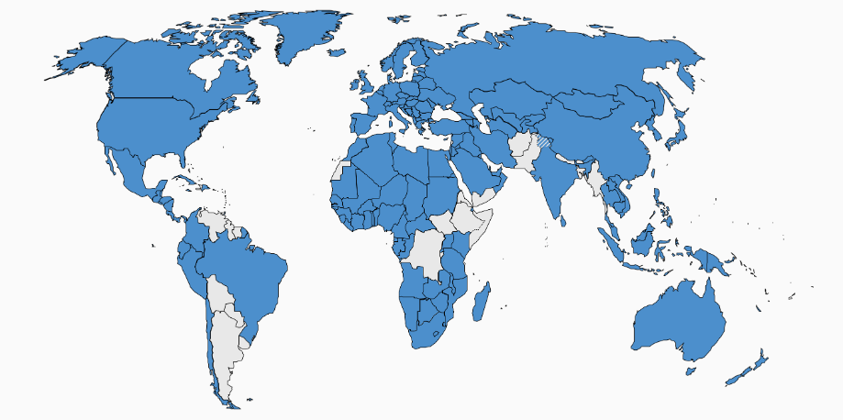
PCT Coverage Today (157 Contracting States)

Slide 9

Recent Accessions

Slide 10
Countries not (yet) PCT Contracting States (36)
Afghanistan
Andorra
Argentina
Bahamas
Bangladesh
Bhutan
Bolivia
Burundi
Democratic Republic of Congo
Eritrea
Ethiopia
Fiji
Guyana
Haiti
Kiribati
Lebanon
Maldives
Marshall Islands
Micronesia
Myanmar
Nauru
Nepal
Pakistan
Palau
Paraguay
Solomon Islands
Somalia
South Sudan
Suriname
Timor-Leste
Tonga
Tuvalu
Uruguay
Vanuatu
Venezuela
Yemen

Slide 11
Growth in PCT applications 1978-2022
278,100 filed in 2022 (+0.3%)

Slide 12

International applications in 2022 by country of origin
Asia: 54.7%
IN: +25.4%
KR: +6.2%
FR: +5.9%
25% originating in China, 21% in US, 18% in Japan
64% from the top 3 countries, 79% from top 5 countries, 92% of filings from top 15 countries

Slide 13
PCT Timeline

Slide 14
PCT TIMELINE
Request for
supplementary international
search (optional)
International publication
National/Regional/
PCT filing/
(priority date)
International search report (ISR) and written opinion (WO) of ISA
Supplementary
international
search report (SISR)
PCT filing
30
National
phase entry
(months)
0
12
16
18
22
28
2 months from ISR:
filing of claims amendments (optional)
IB communicates
IPRP (Chapter I or II)
to DOs/EOs
IPRP (Chapter II)
established
Filing of demand and Article 34
amendments and/or arguments
(optional)

Slide 15
Priority Claims
PCT requirements
Priority documents

Slide 16
Contents of priority claims (Rule 4.10) (1)
Earlier national application:
  filing date
  application number
  country party to the Paris Convention or Member of WTO in which earlier application was filed
Earlier regional application:
  filing date
  application number
  authority entrusted with the granting of regional patents (in practice, the regional Office concerned)

Slide 17
Contents of priority claims (Rule 4.10) (2)
Earlier PCT application:
  international filing date
  international application number
  RO with which the earlier PCT application was filed
After filing the PCT application, check Form PCT/IB/301 (Notification of receipt of record copy at IB)
  Does it reflect the correct priority date?

Slide 18
Furnishing of priority documents
(Rule 17.1)
Where the priority of an earlier national, regional or international application is claimed, the applicant must provide a priority document for each corresponding earlier application (that is, a certified copy of the earlier application)
  by furnishing it directly to the RO or IB (Rule 17.1(a)), or
  by requesting the RO to prepare and transmit it to the IB (Rule 17.1(b)), if the earlier application was filed with that Office, or
  by requesting the IB to obtain the priority document from a digital library (Rule 17.1(b-bis)) (only for Offices participating in the Digital Access Service (DAS)

Slide 19
Digital Access Service for Priority Documents (DAS)
Legal Basis:
  PCT Rule 17.1(b-bis)
  Administrative Instructions 715 and 716
Applicants may request the IB to retrieve priority documents from digital libraries (may also be possible at some DOs)
Participating Offices: AR, AT, AU, BR, CA, CL, CN, CO, DK, EA, EE, EP, ES, EUIPO, FI, FR, GB, GE, IB, IL, IN, IT, JP, KR, MA, MX, NL, NO, NZ, SE, US
For detailed information on DAS, see: www.wipo.int/das/en

Slide 20
Main steps for the use of DAS
Request the Office of first filing (OFF) to make the earlier application available via DAS
The OFF (or, in some cases, the IB on behalf of the OFF) provides the applicant with an access code
Request the IB to retrieve the priority document via DAS by checking the appropriate box on the request form and include the access code (after filing, the request to the IB to retrieve the priority document via DAS can also be made using ePCT)
The IB retrieves the priority document via DAS and sends a confirmation of retrieval to the applicant (Form PCT/IB/304)

Slide 21
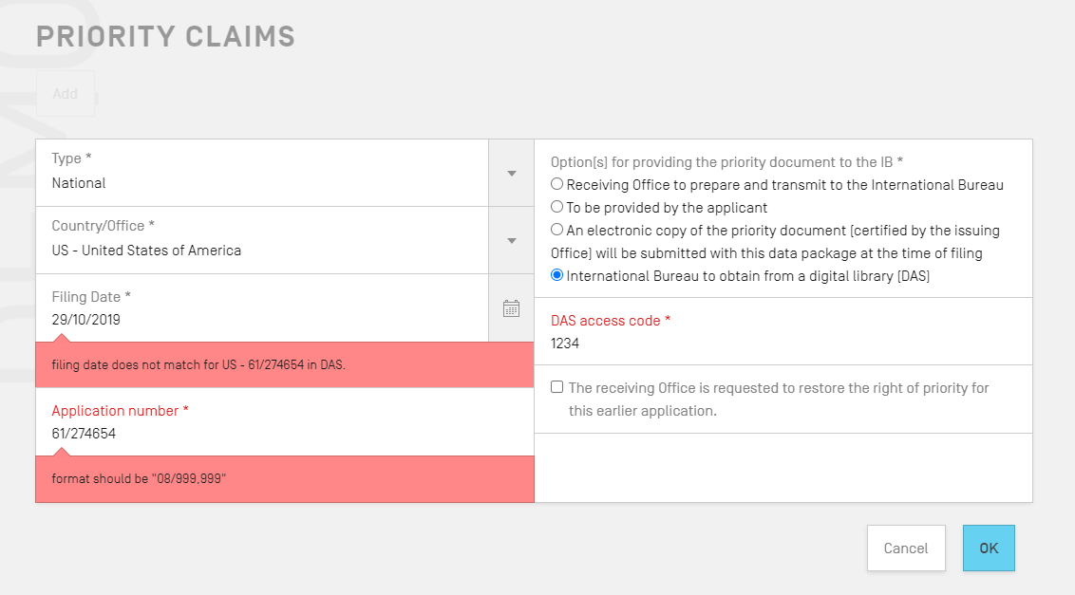
Requesting DAS p-doc retrieval

Slide 22
Time limit for furnishing priority documents (Rule 17.1)
Direct submission by the applicant to the RO:
  within 16 months from the priority date
Direct submission by the applicant to the IB:
  before international publication
Request to the RO to prepare and transmit the priority document to the IB:
  within 16 months from the priority date (check-box in Request form)
Submission via DAS to IB:
  The priority document must be made available to the IB via DAS and the request to the IB to retrieve the priority document must be made before international publication
Monitor receipt of Form PCT/IB/304 before international publication

Slide 23
PCT-Direct

Slide 24
“PCT Direct” (1)
Additional service offered by:
  EPO
  Israel Patent Office
  Finnish Patent and Registration Office
  Spanish Patent and Trademark Office
During the PCT procedure, applicants can address patentability issues raised in the search opinion established for the priority application by the same office
Aims at improving the efficiency and quality of the procedure before the ISA
Further details can be found on the websites of the Offices concerned

Slide 25
“PCT Direct” (2)
Requirements:
  the informal comments are filed together with the PCT application
    with any RO if ISA/EP, ISA/ES, ISA/FI or ISA/IL is chosen
  ISA/EP, ISA/ES, ISA/FI or ISA/IL are selected
  the PCT application claims priority of an earlier application searched by the
    ISA/EP (European first filing or national first filing)¹
    ISA/ES
    ISA/FI
    ISA/IL
Form:
  the informal comments are filed in form of a “PCT Direct Letter” in a single document in PDF format and the words “PCT Direct/informal comments” have been indicated under “Other” in Box IX of the PCT request form (Form PCT/RO/101)
¹ The EPO performs national searches for France, Netherlands, Belgium, Luxembourg, Italy, Turkey, Greece, Cyprus, Malta, San Marino, Lithuania, Latvia and Monaco

Slide 26
“PCT Direct” (3)
Informal comments:
  They are arguments regarding the patentability of the claims of the PCT application
  May include explanations regarding any modifications to the application documents, in particular to the claims, in comparison with the earlier application (e.g. marked-up copy)
  Aim at overcoming objections raised in the search opinion established for the priority application
  Do not form part of the PCT application, but are made publicly available on PATENTSCOPE

Slide 27

Possibility of amendments under national law
Enter
national
phase
(months)
0
0-12
12
16
22
30
File local
application
Receive
local
search
opinion
(same Office as
ISA)
File PCT
application
International
search report & written opinion
(optional)
File
demand for
International
preliminary
examination
Possibility of comments on local search opinion in view of adding value to ISR and WO
“PCT Direct Letter”
Possibility of amendments and/or arguments to IPEA

Slide 28
Declarations

Slide 29
Declarations under Rule 4.17
Purpose: possibility to anticipate certain national phase requirements during the international phase (Rule 51bis.2)
Inclusion in request or subsequent filing is optional
Declarations relate to the following matters (Rule 4.17):
  identity of the inventor
  applicant’s entitlement to apply for and be granted a patent
  applicant’s entitlement to claim priority of an earlier application
  declaration as to inventorship (for the US designation only)
  non-prejudicial disclosures or exceptions to lack of novelty

Slide 30
Formal requirements
Declarations must use standardized wording as prescribed in Sections 211 to 215 of the Administrative Instructions, relating to situations that existed on the international filing date
Where a declaration has been furnished, no documents or evidence as to that matter may be required by the designated/elected Office
  unless that Office may reasonably doubt the veracity of the declaration; and/or
  evidence concerning non-prejudicial disclosures or exceptions to lack of novelty may be required

Slide 31
Declaration of inventorship (Rule 4.17(iv))
(only for US designation)
All inventors need to be named in the same declaration
Declaration must be signed and dated by all inventors
Signatures may appear on different copies of the same complete declaration (in ePCT external signature function)
Signature does not have to be an original
DO/US accepts a seal as signature when the international application is filed with ROs which accept seals as signatures

Slide 32
Publication of declarations
Declarations received within the applicable time limit will be mentioned on the front page of the published international application
The full text of the declarations will be published as part of the international application

Slide 33
Addition/correction of declarations
(Rule 26ter)
Applicants may correct or add any of the declarations filed under Rule 4.17
Time limit: until the expiration of 16 months from the priority date (or even later, provided that the declaration is received by the IB before the technical preparations for international publication have been completed)
The RO or IB may invite the applicant to correct any declaration that is not worded as required or, in the case of the declaration of inventorship (Rule 4.17(iv)), is not signed as required

Slide 34
Declarations referred to under Rule 4.17: Additional issues
  National forms should not be used for declarations in the international phase (for instance, a combined declaration of inventorship/ power of attorney) since they do not use the standardized wording
  When a declaration is furnished after the international filing date, no further page fee would be required
  If a defective declaration is not corrected during the international phase:
    does not affect the processing of the declaration by the International Bureau
    DOs/EOs may accept defective declaration
  No provision for the withdrawal of declarations

Slide 35
Correction of defects

Slide 36
Defects which may result in a later international filing date
(Rules 20.5 and 20.5(bis))
Missing sheets or furnishing of correct elements of parts of
  description
  claims “
  drawings
Attention if you receive Forms PCT/RO/103 or 107

Slide 37
Defects which can be corrected without affecting the international filing date (1)
RO not competent because of the applicant’s nationality or residence (Article 11(1)(i), Rule 19.4(a)(i))
International application (description and claims) filed in a language not accepted by RO (Rule 19.4(a)(ii))
Errors in the indication of the applicant’s nationality and/or residence (Section 329 of the Administrative Instructions)
Non-admitted language for the request, abstract, text matter in drawings (Rule 26.3ter)
Incomplete, erroneous or missing priority claim (Rule 26bis) Attention if you receive Form PCT/RO110 (or IB/316)

Slide 38
Defects which can be corrected without affecting the international filing date (2)
Missing signature in the request (Rule 4.15)
Incomplete or erroneous declarations under Rule 4.17 (Rule 26ter)
Formal defects (Rules 11 and 26) Form PCT/RO/106
Missing title of the invention
Missing abstract
Obvious mistakes (Rectification under Rule 91)
Unpaid or not fully paid fees (Rule 16bis), Form PCT/RO/133
Not timely furnished translation (Rule 12.3(d)) Form PCT/RO/150

Slide 39
Questions - Fees
One month after filing no fee has been paid yet. The RO has backlogs in processing and has not sent any invitation (Form PCT/RO/102) yet. What should you do?
  Wait to receive an invitation
  Pay asap with a late payment fee
  Pay asap without late payment fee

Slide 40
Incorporation by reference

Slide 41

Houston, we have a problem ...
There is a page missing!!!
I filed the wrong drawings!!!

Slide 42
Incorporation by reference of missing or correct elements and parts of the international application (Rules 20.5 and 20.5bis) (1)
Objective: Enable inclusion of accidentally omitted elements or parts that are contained in a priority application without affecting the international filing date
  element = all of the description or all of the claims
  part = part of the description, part of claims or part or all of pages of drawings
Erroneously filed elements or parts cannot be removed through incorporation by reference

Slide 43
Incorporation by reference of missing or correct elements and parts of the international application (Rules 20.5 and 20.5bis) (2)
Conditions:
  priority must have been claimed on the original filing date (Rule 4.18)
  priority application contains the element or part (Rule 20.6(b))
  request contains statement of (conditional) incorporation by reference (Rule 4.18)
  timely confirmation (Rules 20.6 and 20.7)
Competent Authority: RO

Slide 44
Missing erroneously filed completed/corrected
≠
≠
?
√
P-Doc
√
√
P-Doc
X
X
√
X
Later international filing date
?
√
X

Slide 45
Confirmation of incorporation by reference
(Rules 20.5bis, 20.6 and 20.7) (1)
Time limit: two months from filing or from invitation to correct (Rule 20.7)
Documents to be filed (Rule 20.6):
  notice of confirmation
  missing or correct sheets
  copy of the earlier application as filed unless the priority document already submitted
  translation if not in the language of the international application
  indication as to where in the priority document (and translation) the missing parts are contained

Slide 46
Invitation by RO to correct defect under Article 11(1)
(Rule 20.3)
Where the entire description or all claims are missing: Form PCT/RO/103, RO invites the applicant to either
  furnish a correction under Article 11(2) and the international application is accorded a later filing date or,
  confirm under Rule 20.6(a) that the element is incorporated by reference under Rule 4.18 and the international filing date is maintained

Slide 47
Confirmation of incorporation by reference (Rules 20.5bis, 20.6 and 20.7) (2)
If not all requirements for incorporation by reference are fulfilled (Form PCT/RO/126)
(for example, if a missing element or part is not entirely contained in the earlier application):
  the international application is assigned a later filing date (date of receipt of missing or correct element or part),
  applicant may request that missing part or the correct element or part be disregarded (Rule 20.5(e) and Rule 20.5bis(e))

Slide 48
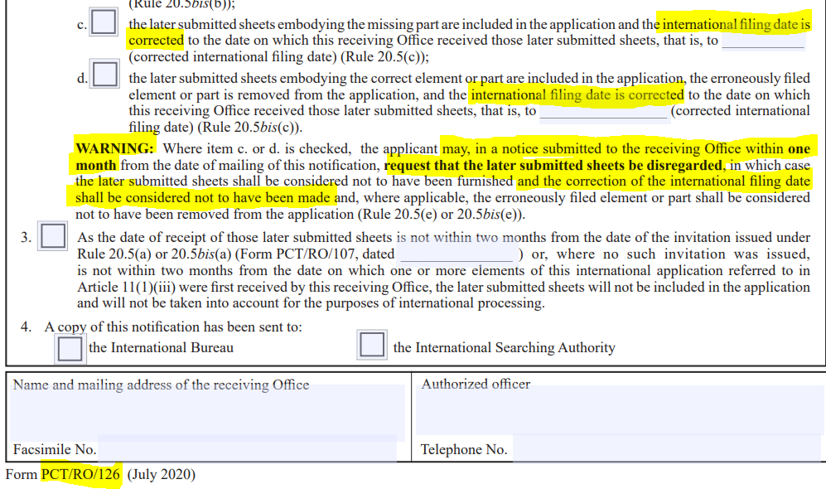

Slide 49
Effect of incorporation by reference in the national phase (Rule 82ter.1(b))
DOs may, to a limited extent, review the decision allowing the incorporation by reference
Declarations of incompatibility with the national law (reservations) were made by a number of ROs and DOs
See WIPO website at:
www.wipo.int/pct/en/texts/reservations/res_incomp.html
    DOs and missing elements/parts (Rule 20.8(b)):
    CN, CU, CZ, DE, ID, KR, MX, TR
    DOs and erroneously filed elements/parts (Rule 20.8(b-bis)):
    CL, CN, CU, CZ, DE, ES, ID, KR, MX, TR (EP withdrew its notification of incompatibility from 1 November 2022)

Slide 50
Correction and addition of priority claims

Slide 51
Correction/addition of priority claims
What can be the problem?
  missing priority claim
  missing priority date
  missing indications of the date, number or country of filing
  filing date of earlier application more than 12 months before the international filing date
  earlier filing not in a country party to the Paris Convention or a Member of WTO
Applicable provisions:
  Article 8
  Rules 4.10, 26bis, 48.2(a)(vii) and 91

Slide 52
Correction/addition of priority claims affecting the priority date (Rule 26bis) (1)
Cases concerned:
  adding a priority claim with an earlier filing date than any priority claim present in the application
  correction of the filing date of the earliest priority claim

Slide 53
Correction/addition of priority claims affecting the priority date (Rule 26bis) (2)
Applicable time limit:
  within 4 months from the international filing date; or
  possibly later, if the earlier of the following two time limits expires later than the 4-month time limit:
    16 months from the priority date before the correction or addition
    16 months from the priority date after the correction or addition
  any correction received before the RO or IB has declared the priority claim to be void and not later than one month after the expiration of the above time limit, will be considered as timely received (Rule 26bis.2(b))
  NOTE: This does not apply to late additions of priority claims

Slide 54
Correction/addition of priority claims not affecting the priority date (Rule 26bis) (1)
Cases concerned:
  corrections which do not affect the filing date of the priority claim
  adding a priority claim with a later filing date than the earliest priority claim present in the application (e.g. second priority claim)
  corrections of the filing date of a priority claim which is not the earliest one

Slide 55
Correction/addition of priority claims not affecting the priority date (Rule 26bis) (2)
Applicable time limit:
  Rule 26bis.1(a):
    within 4 months from the international filing date; or
    within 16 months from the priority date, whichever time limit expires later
    any correction received before the RO or IB has declared the priority claim to be void and not later than one month after the expiration of the above time limit, will be considered as timely received (Rule 26bis.2(b))
  NOTE: This does not apply to late additions of priority claims
  Rule 91: within 26 months from the priority date

Slide 56
Invitation to correct by RO or IB (1)
Forms:
  receiving Office: Form PCT/RO/110
  International Bureau: Form PCT/IB/316
Invitation (Rule 26bis.2(a)), is issued if:
  priority claim does not comply with requirements of Rule 4.10
  any indication in the priority claim is inconsistent with the corresponding indication appearing in the priority document
  International application has an international filing date outside the priority period

Slide 57
Invitation to correct by RO or IB (2)
The RO will also draw the attention of the applicant to the possibility to request restoration of the priority right (Rule 26bis.3) if the international filing date is outside of the priority period but within a period of two months from the date of expiration of the priority period
If the applicant does not correct the priority claim in response to the invitation, the priority claim concerned will be considered void, for the purposes of the procedure under the PCT (Rule 26bis.2(b)) – with exceptions on the following slide

Slide 58
Invitation to correct by RO or IB (3)
However, a priority claim will not be considered void only because (Rule 26bis.2(c)):
  the indication of the number of the earlier application is missing; or
  an indication in the priority claim is not the same as the corresponding indication appearing on the priority document; or
  the international filing date is outside of the priority period but within a period of two months from the date of expiration of the priority period

Slide 59
Publication related to priority claims
(Rule 26bis.2(e))
After the expiration of the applicable time limit to correct or add a priority claim, applicant may request the IB (Rule 26bis.2(e)) to publish information concerning the priority claim concerned:
  within 30 months from priority date; and
  subject to the payment of a fee
The publication will not correct the priority claim but serve to alert third parties that correction/addition may be attempted in the national phase.

Slide 60
Restoration of the right of priority

Slide 61
Restoration of the right of priority -
Competent Authorities
RO during the international phase
(Rule 26bis.3)
DO during the national phase
(Rule 49ter.2)

Slide 62
Restoration by RO (Rule 26bis.3)
Conditions:
  request to restore must be filed with the RO
  time limit: within a period of 2 months from the date of the expiration of the priority period
  filing of statement of reasons for failure to comply with the time limit
  statement should preferably be accompanied by a declaration or other evidence to support such statement
  where applicable, payment of the required fee

Slide 63
Restoration of the right of priority
Applicable criteria
Applicable Rules: 26bis.3(a) and 49ter.2(a)
Two possible criteria for restoration:
  failure to file the application within the priority period occurred in spite of due care required by the circumstances having been taken
  failure to file the application within the priority period was unintentional
All Offices must apply at least one of these criteria and may apply both; DOs may also apply a more favorable criterion in accordance with their national law

Slide 64
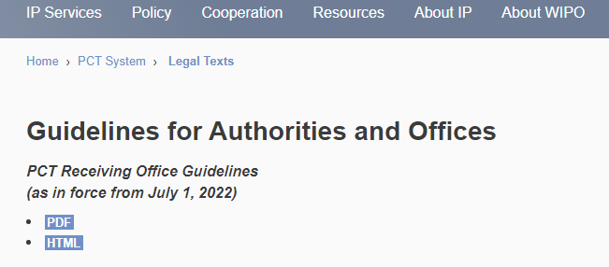
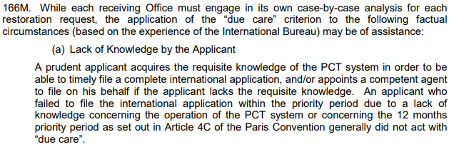
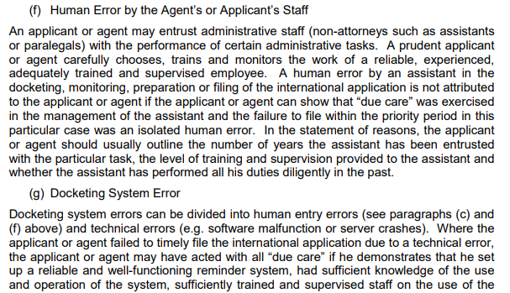
PCT Receiving Office Guidelines, para. 166M

Slide 65
Restoration by RO
Communication of documents to the IB
General Rule: Obligation of the RO to forward to the IB all documents received from the applicant in relation to a request to restore the priority right
Exception:
  Upon reasoned request by the applicant or on its own decision, the RO may not forward information, if
    it does not obviously serve the purpose of informing the public about the international application,
    publication of or public access to such information would clearly prejudice the personal or economic interests of any person, and
    there is no prevailing public interest to have access to that information
  The applicant may be required to submit replacement sheets

Slide 66
Effects of refusal to restore by RO
(Rule 26bis.3)
  Any priority claim to an earlier application filed less than 14 months before the international filing date
    will not be declared void even if priority is not restored by the RO (Rule 26bis.2(c)(iii))
    will serve as a basis to calculate time limits during the international phase
  The validity of such a priority claim in the national phase is not assured

Slide 67
Effects of restoration in the national phase (Rule 49ter.1)
Effect of restoration by RO in the national phase:
  RO restoration based on the “due care” criterion is effective in all DOs
  RO restoration based on the “unintentional” criterion is effective in those DOs which apply that criterion (or a more lenient one)
  RO restoration is not conclusively binding on DOs: limited review by DOs is possible
  RO refusal to restore is not binding on DOs
For declarations of incompatibility with the national law (reservations), see the WIPO website at: www.wipo.int/pct/en/texts/reservations/res_incomp.html

Slide 68
Reservations made by Offices
The following Offices have notified the IB of the
incompatibility of Rule 26bis.3(a) to (i), Rule 49ter.1(a) to (d) and/or Rule 49ter.2(a) to (g) with their national/regional law:
  Incompatibility as RO (Rule 26bis.3(j)):
  BR, CO, CU, CZ, DE, DZ, GR, ID, IN, KR, PH
  Incompatibility of the effect of decision of RO on DO (Rule 49ter.1(g)):
  BR, CN, CO, CU, CZ, DE, DZ, ID, IN, KR, LT, MX, PH
  Incompatibility as DO (Rule 49ter.2(h)):
  BR, CA, CN, CO, CU, CZ, DE, DZ, ID, IN, KR, MX, PH
See the Table of “PCT Reservations, Declarations, Notifications and Incompatibilities” www.wipo.int/pct/en/texts/reservations/res_incomp.html

Slide 69
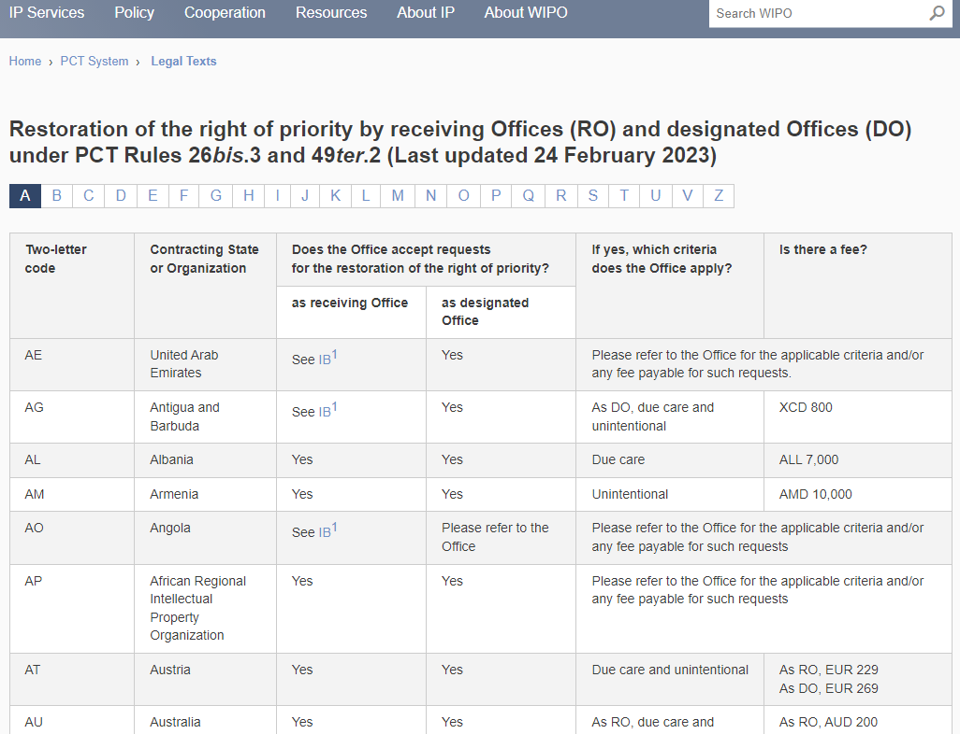

Slide 70
Questions – priority claims
On 8 April 2022 you filed a first patent application and on 6 April 2023 a PCT application. You have omitted to claim priority to the first filing. What can be done ?
  Submit a notice to IB to add the priority claim
  Request restoration of priority right
  Request publication of information concerning a priority claim which can no longer be added.

Slide 71
Recording of changes under Rule 92bis

Slide 72
Rule 92bis: cases covered
Change of name
Change of address
Change of nationality
Adding/deleting an inventor
Change of applicant (assignment, addition, deletion)
Change of agent

Slide 73
Request for recording of a change under Rule 92bis
ePCT action
Generally no evidence of the change is required during the international phase (the DOs may, however, require that evidence (for example, assignment) be submitted once the national phase has been entered)
The IB will notify the applicant that the requested change has been recorded
Monitor receipt of Form PCT/IB/306

Slide 74
Recording of a change in the person of the applicant under Rule 92bis
Where such request is made by a person not yet named in the request (“the new applicant”) without the written consent of the (“old”) applicant, a copy of an assignment or other documentary evidence supporting the change in person must be filed with the request for the change
Where such request is made by an agent of the new applicant, a power of attorney signed by the new applicant must be furnished at the same time

Slide 75
Time limit under Rule 92bis (1)
The request must reach the IB before the expiration of 30 months from the priority date
  Therefore, it is recommended to file it directly with the IB even though it is possible to file it also with the RO
If it reaches the IB after the expiration of the applicable time limit, the change will not be recorded and the applicant will have to proceed with such request before each DO or EO concerned

Slide 76
Time limit under Rule 92bis (2)
If the applicant wishes that a particular change be taken into account for the international publication, the request for change must reach the IB before the completion of technical preparations for international publication (15 days before the actual date of publication)

Slide 77
Questions – corrections/rectifications
On the day of international publication you notice a typographical error in the date of the only priority claim. Can it still be corrected and if so, how?
  Yes, submit a notice to the IB to add the priority claim
  Yes, submit to the IB a request to record a change (Rule 92bis)
  Request the ISA to authorize a rectification of an obvious mistake (Rule 91)
  No, but you can ask the IB to publish information about a priority claim which can no longer be corrected (Rule 26bis.2(e))

Slide 78
Entry into the national phase

Slide 79
General national requirements
Art. 22(1) and 39(1)(a)
Requirements:
  Translation, if applicable
  Payment of national fee
  Copy of international application in particular circumstances only
Time limit under Art. 22(1): 30 months from the priority date
  For additional time, see PCT Applicant’s Guide, national phase summaries
  For exceptions, see
  www.wipo.int/pct/en/texts/reservations/res_incomp.html
Time limit under Art. 39(1)(a): 30 months from the priority date
  For additional time, see PCT Applicant’s Guide, national phase summaries

Slide 80
Special national requirements
(Art. 27 and Rule 51bis.1)
Time limit under Rule 51bis.3:
  If requirements are not fulfilled within the time limit for entry into national phase under Art. 22 or 39:
    Invitation by DO
    At least 2 months from the invitation

Slide 81
Examples of special requirements under Rule 51bis.1 (1)
Oath or declaration by the inventor (US only):
Where the corresponding declaration has been furnished during the international phase or directly to the DO/EO, no documents or evidence as to that matter may be required by DO/EO/US unless that Office may reasonably doubt the veracity of the declaration
Assignment documents (of the priority rights or of the application):
Where the corresponding declaration has been furnished during the international phase or directly to the DO/EO, no documents or evidence as to that matter may be required by the DO/EO unless that Office may reasonably doubt the veracity of the declaration

Slide 82
Examples of special requirements under Rule 51bis.1 (2)
Translation of the priority document may only be required
(Rule 51bis.1(e)):
  where the validity of the priority is relevant to
  the determination whether the invention is patentable
  in cases of incorporation by reference
Appointment of local agent and submission of power of attorney
Translation or other documents relating to the international application in more than one copy
Certified translation of the international application (only where the Office may reasonably doubt the accuracy of the translation)

Slide 83
National requirements simplified for
PCT applications (1)
Priority document
  The applicant does not need to furnish the priority document since the IB transmits copies to the DO/EOs
  If the DO/EO did not receive a copy of the priority document from the IB, it must request a copy from the IB (not from the applicant)
Drawings
  If the drawings do not contain any text matter to be translated, a simple copy of the drawings as filed is required by a few DOs
  If the drawings contain text matter to be translated, a set of drawings containing the translated text matter needs to be furnished

Slide 84
National requirements simplified for
PCT applications (2)
No legalized or certified translation of the international application
  Otherwise, a simple translation is required
  A few Offices (such as, AU, GB, IN, NZ, SG, ZA) require a "verified" translation
No special form required (but strongly recommended) for entry into national phase

Slide 85
Furnishing by IB of copies of priority documents (Rule 17.2(a))
The International Bureau provides copies of priority documents to designated Offices:
  upon request
  after international publication, unless the applicant made a specific request for early processing under Article 23(2)
Almost all Offices request a copy of the priority document only after the application entered the national phase
Only the European Patent Office systematically receives copies of all priority documents

Slide 86
Recommendations for preparing entry into the national phase (1)
Leave sufficient time, where necessary, to prepare the translation of the international application
Send your local agent, copies of the (relevant) documents on file: the published international application, the international search report and written opinion by the ISA, the international preliminary examination report, priority documents; note that none of these documents are required to be filed by the local agent at the local patent office

Slide 87
Recommendations for preparing entry into the national phase (2)
Where you would prefer avoiding paying additional claims fee or other fees that are applicable under any particular national law, prepare the application, and any amendments thereof, according to the national practice
Even though several DOs/EOs provide for longer time limits, it is preferable to docket the 30-month time limits for all Offices (See www.wipo.int/pct/en/texts/reservations/res_incomp.html for exceptions under Article 22(1))

Slide 88
A few further tips to remember
Remember to monitor time limits for entering national phase
  they apply irrespective of delays in the international phase
Make necessary indications that application is entering the national phase, i.e., that it is not a direct national filing
Translation of the international application must be correct and complete (no subject matter may be added and/or deleted)
Pay the required fees (amount may be different from that applicable to direct national filing)

Slide 89
Reinstatement of rights by DO/EOs
(Rule 49.6) (1)
Available in certain DO/EOs, where the applicant has missed the time limit under Article 22 or 39(1) to enter the national phase:
  unintentionally
  or - at the option of the Office -
  in spite of due care required by the circumstances

Slide 90
Reinstatement of rights by DO/EOs
(Rule 49.6) (2)
Applicants may submit a request for reinstatement and enter the national phase within:
  2 months from the date of removal of the cause of the failure to meet the time limit to enter national phase; or
  12 months from the date of expiration of the time limit to enter national phase;
  whichever period expires first

Slide 91
DO/EOs to which Rule 49.6 does not apply
Notifications of incompatibility with respective national law were filed in accordance with Rule 49.6(f):
CA Canada LV Latvia
CN China MX Mexico
DE Germany NZ New Zealand
IN India PH Philippines
KR Republic of Korea PL Poland
The national law applicable by some of these Offices may nevertheless provide for other forms of protection against loss of rights - for further details, see for each DO/EO, the relevant National Chapter in the PCT Applicant’s Guide, National Phase

Slide 92
Additional cases of protection against loss of rights
Other than the (minimum) protection under Rule 49.6: excuse of delays in meeting time limits by DOs/EOs (Article 48 and Rule 82bis)
Rectification by DOs/EOs of errors made by RO or IB (Rule 82ter)
Review by and opportunity to correct before the DOs/EOs (Articles 24(2), 25, 26, 39(3) and 48, Rules 82bis and 82ter)

Slide 93
Non-applicability of time limit of 30 months under Article 22(1)
The Offices of the following two States have notified the IB that they do not apply the 30 month time limit under Chapter I, as of 1 April 2002, for as long as modified Article 22(1) is not compatible with their national law:
    LU Luxembourg
    TZ United Republic of Tanzania
If no demand for international preliminary examination is filed before the expiration of 19 months in respect of above States, the national phase will have to be entered before the expiration of 20 or 21 months from the priority date
As distinct from the national phase in LU and TZ, the regional phase can be entered within 31 months at the EPO and ARIPO respectively for those countries

Slide 94
Patent Prosecution Highway (PPH) and PCT

Slide 95
Patent Prosecution Highway (PPH) and PCT
Accelerated examination in the national phase based on a positive work product of an International Authority (written opinion of the ISA or the IPEA, IPRP (Chapter I or II))
Conditions:
  At least one claim has been determined by the ISA or the IPEA to meet the PCT criteria of novelty, inventive step and industrial applicability; and
  ALL the claims must sufficiently correspond to the claims deemed to meet the PCT criteria (they are of the same or similar scope or they are of narrower scope than the claims in the PCT application)
Global PPH and PCT:
  Introduction of Global PPH Pilot in January 2014
  Single set of qualifying requirements that simplifies the existing PPH network so that it is more accessible for users

Slide 96
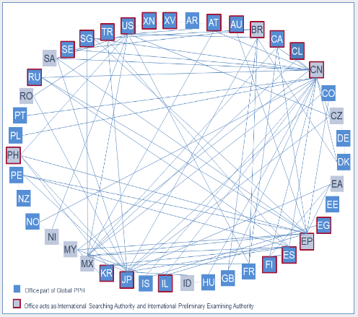
Patent Prosecution Highway (PPH) and PCT

Slide 97
Patent Prosecution Highway (PPH) and PCT
Global PPH complements existing bilateral PPH agreements
Information on the PCT Website:
www.wipo.int/pct/en/filing/pct_pph.html
Information on the PPH Portal:
www.jpo.go.jp/ppph-portal/index.htm
Information on procedures and forms can be found on the websites of the participating Offices
The IB requests feedback on experience with PCT-PPH at pct.legal@wipo.int

Slide 98
New WIPO Standard ST.26
New requirement for presenting nucleotide and amino acid sequences for applications filed on or after July 1, 2022

Slide 99
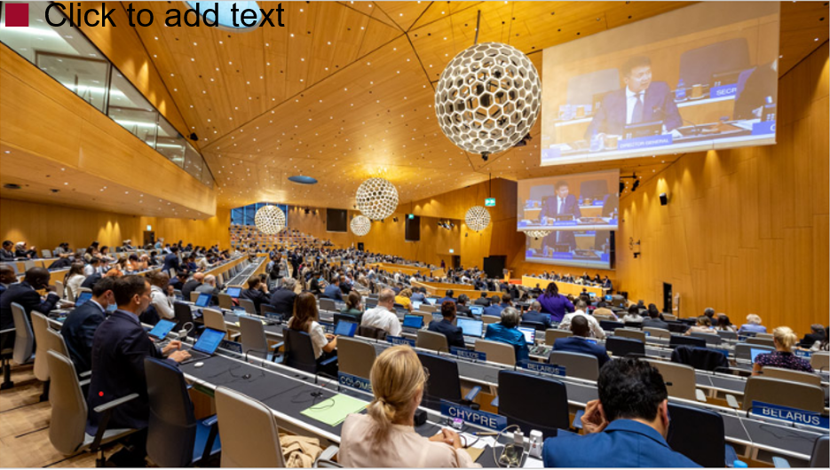
Why a new Standard?
Compliance with international sequence database standards
Reflect advances in biotechnology
  E.g., branched sequences, D-amino acids and nucleotide analogs
Structured data allows automated validations and facilitates data exchange
Harmonize practices across all patent offices

Slide 100
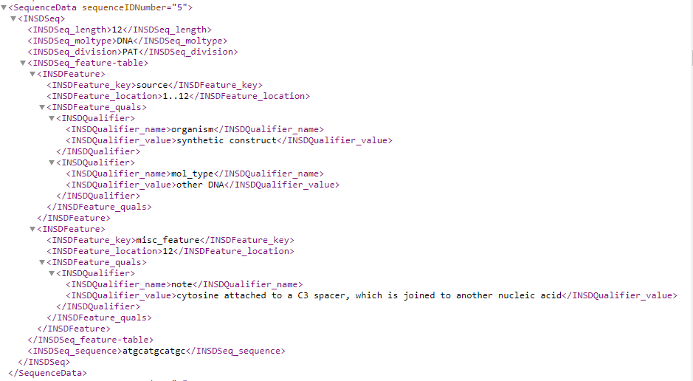
ST.26 Sequence Listing

Slide 101
PCT requirements (Rule 5.2(a))
WIPO Standard ST.26 replaces ST.25 since July 1, 2022
Amended Rule 5.2(a): Where the international application contains disclosure of nucleotide and/or amino acid sequences that, pursuant to the Administrative Instructions, are required to be included in a sequence listing, the description shall include a sequence listing part of the description complying with the standard provided for in the Administrative Instructions.
ST.26 is the Standard provided for in Annex C of the Administrative Instructions

Slide 102
Sequence listing filed on international filing date
Can only be considered a sequence listing part of the description if filed in the correct format (XML)
  Application filed electronically
    Separate XML file containing sequence listing
  Application filed on paper
    sequence listing in XML on physical media
RO only required to confirm the correct file type (XML)
If filed in ST.25, cannot simply replace with ST.26
  Applicant may only add the content as sheets of the description

Slide 103
Non-compliant file type submissions
RO informs the applicant that the sequence listing must be filed in XML under ST.26
Invites the applicant to confirm addition of the content as sheets of the main part of the description
  May require additional fee (sheets in excess of 30)
If no confirmation/payment, the submission will not be part of the international application

Slide 104
Sequence listing language requirements (Rule 12)
Only applies to the language-dependent free text
Each RO determines the language(s) it accepts
  May be different from the language of the main body of the application
  RO/IB accepts any language
RO may permit more than one language
  English + another
Transmittal to RO/IB under Rule 19.4

Slide 105
Sequence listing for search purposes (Rule 13ter.1) (1)
International Authorities may invite the applicant to furnish a standard-compliant sequence listing
  in a language accepted by the ISA
  with a statement that it does not go beyond the original disclosure
  late furnishing fee
If the applicant fails to furnish a standard-compliant sequence listing, the ISA is only required to search to the extent a meaningful search can be done without the sequence listing

Slide 106
Sequence listing for search purposes (Rule 13ter.1) (2)
A sequence listing furnished for search (Rule 13ter) does not form part of the international application
The ISA forwards any Rule 13ter sequence listing to the International Bureau, to be made available on PATENTSCOPE

Slide 107
International publication
Sequence listing published as a separate XML file
WIPO has develop a sequence listing reader integrated into PATENTSCOPE

Slide 108
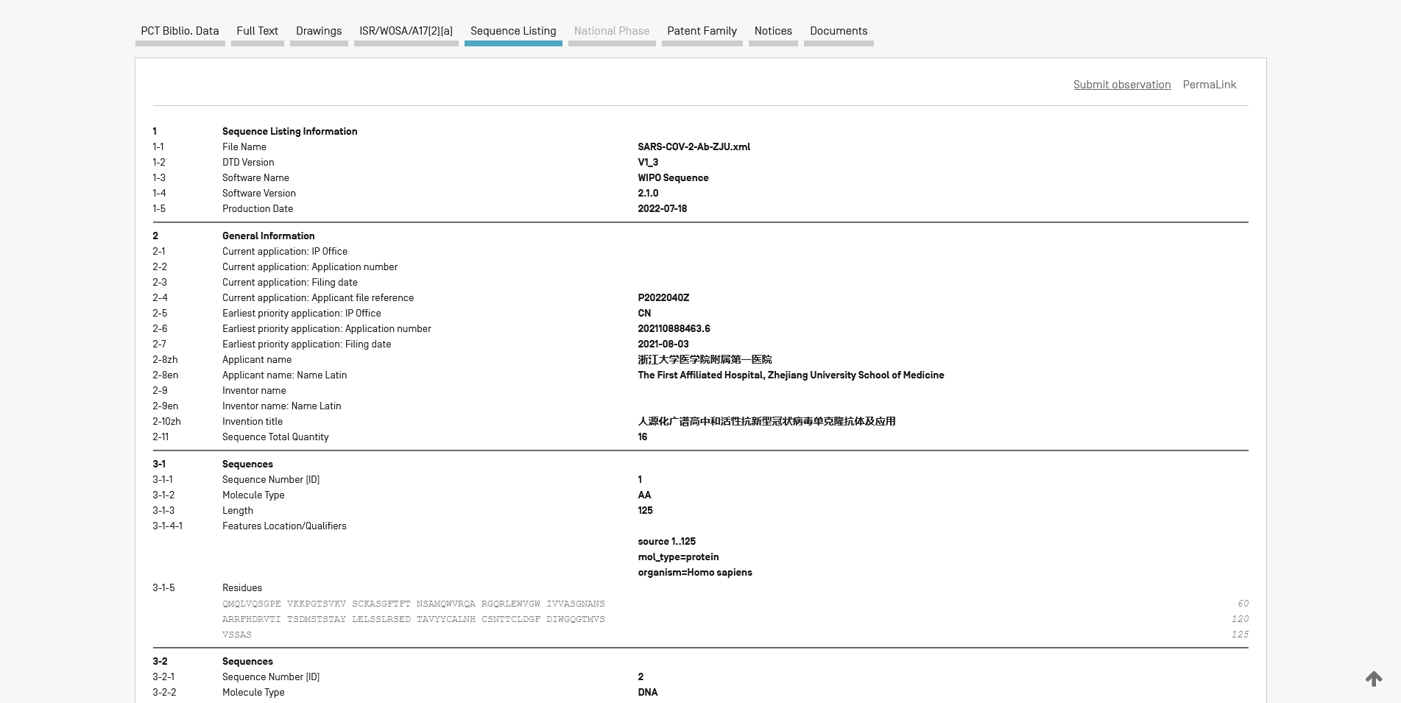

Slide 109
National phase requirements
(Rules 13ter.3 and 49.5(a-bis))
No DO/EO may require a sequence listing other than one complying with WIPO Standard ST.26
Offices may require translation of the free text contained in the sequence listing:
  into a language the Office accepts for the free text contained in the sequence listing
  may also require translation into English if required by database providers

Slide 110
WIPO Sequence Software
WIPO Sequence (for users)
  Free desktop tool developed by WIPO to support authoring, validation, and generation of ST.26 compliant sequence listings
  https://www.wipo.int/standards/zh/sequence/index.html
  Subscribe for updates
Remember to always validate the sequence listing before filing!

Slide 111
ST.25 versus ST.26
ST.25 | ST.26
ASCII .txt with numeric identifiers | XML with elements and attributes
Not required to include: D-amino acids Linear portions of branched sequences Nucleotide analogs | Must include: D-amino acids Linear portions of branched sequences Nucleotide analogs
Annotation of sequences: - Feature keys only | Annotation of sequences: Feature keys and qualifiers
Permitted to include sequences: < 10 specifically defined nucleotides < 4 specifically defined amino acids | Prohibited sequences: < 10 specifically defined nucleotides < 4 specifically defined amino acids

Slide 112
Questions – Sequence listings (SL)
A PCT application was filed before July 2022 with an ST.25 txt listing. Should the applicant now furnish an ST.26 XML sequence listing when the application enters the national phase?
No, ST.25 continues to apply to applications filed before July 1, 2022
A PCT application is filed now, claiming priority to an application with an ST.25 txt listing. Is it necessary to convert it to ST.26 XML format for the PCT filing?
    Yes
After July 2022 an application was erroneously filed with an ST.25 txt listing. Can it be considered a sequence listing part of the description under Rule 5.2(a)?
    No, only a standard compliant XML listing filed on the international filing date can become a sequence listing part of description satisfying Rule 5.2(a) (while the content of ST.25 could be included as normal pages of the description)

Slide 113
Questions – Sequence listings (SL)
What is the situation if an ST.26 XML is subsequently furnished ?
    It cannot become part of the application without affecting the international filing date (unless incorporation by reference applies).
    If the international filing date is to be maintained, the XML listing will be used for search only (Rule 13ter).
    It may become part of the application later, as an amendment under Art. 34, if a demand for international preliminary examination is filed, or as a national phase amendment.

Slide 114
ePCT Update
(January 2023)

Slide 115
Introduction
New version released on 24 January 2023
What’s New for Applicants in ePCT
  New process for requesting access rights
  WIPO Standard ST.26 for Sequence Listings
  ePCT-Filing: .zip file type for XML specification; new online payment method for RO/IB
  Action: Rule 92bis change request; File reference update
  Others: Declarations under Rule 4.17; Workbench - Filters; ePCT Messages

Slide 116
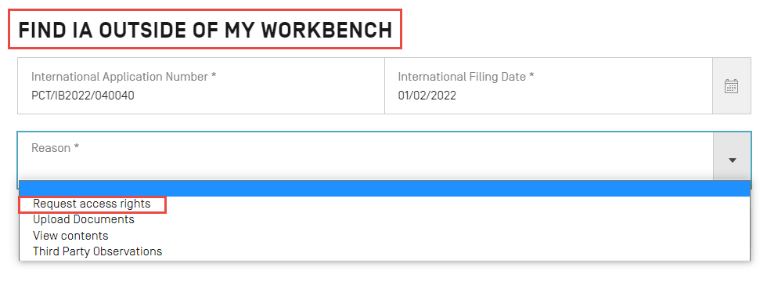
Request Access Rights after Filing (1)
Access rights requests are no longer sent to the IB but instead are sent to the e-mail for correspondence for the applicant/agent on record at the IB

Slide 117
Request Access Rights after Filing (2)
ePCT compares the e-mail of the WIPO Account of the current user with the e-mail for correspondence for the applicant/agent on record at the IB
  If both e-mails are the same, access rights are automatically granted to the current user and any access rights group that was selected as part of the request
  If the e-mails are not the same, the user is presented with an online form to submit the access rights request to the applicant/agent
    applicant/agent to approve or refuse the access rights request via a link to a dedicated webpage

Slide 118
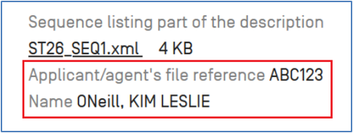
ePCT Filing: SL in ST.26 Format
At the time of adding a sequence listing file in ST.26 format, the applicant/agent’s file reference and the applicant name is extracted and temporarily displayed in the interface to help the user spot if perhaps the wrong file was added in error

Slide 119
ePCT Filing:
Online Payment of Filing Fees for RO/IB
Bank payment online (secured by SOFORT)
  A new online payment method on the WIPO Pay platform for the payment of filing fees in Swiss francs (CHF) to the RO/IB
  Can be used by applicants who have accounts with participating banks in a number of European countries
  Use of SOFORT as an online banking transaction is strongly encouraged where possible
    it enables WIPO’s accounting systems to process payments more efficiently than offline bank transfers as the WIPO Pay reference data is already automatically included as part of the process
Notes:
Apple pay, Samsung pay to be added as well

Slide 120
Declarations under Rule 4.17(iv)
Process improved for Declarations of inventorship
  Possible to manage the external signature requests per declaration
    for example, to delete individual external signature requests if required, without affecting the external signature status of the other declarations

Slide 121
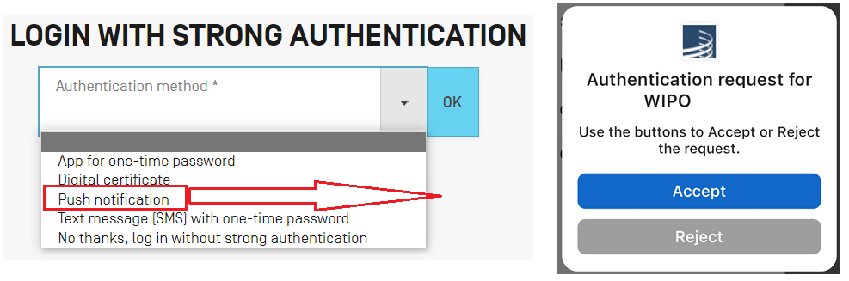
WIPO Account – Push notification
New strong authentication option - Push notification
  Install the ForgeRock app on a mobile device and then register it with your WIPO Account

Slide 122
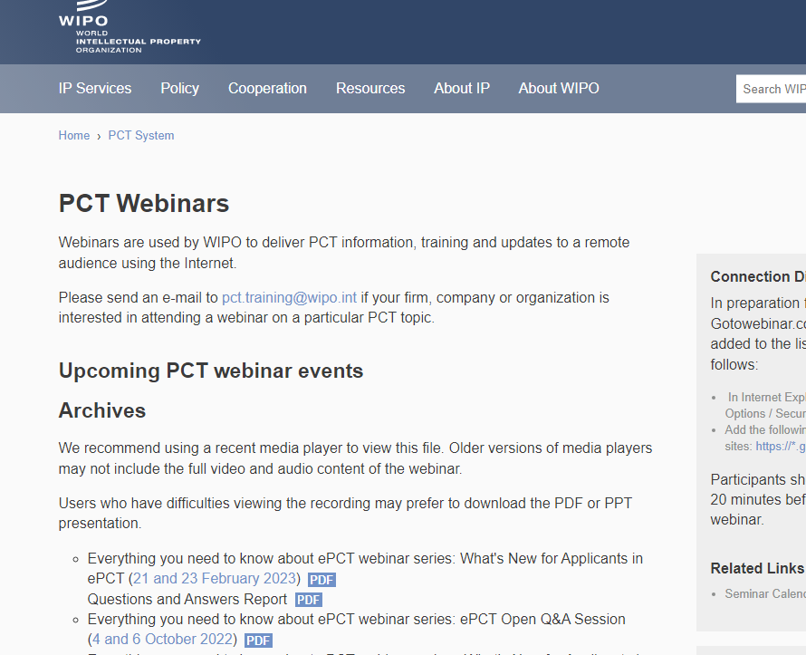

Slide 123
Miscellaneous

Slide 124
Omission of sensitive information from publication/public file access
(Article 21, Rules 48 and 94)
Omission of sensitive information which was accidentally included in the PCT application/file
  Reasoned request of applicant to IB (Form IB/384 may be used)
    Accompanied by replacement sheets
  Time limit for a request to omit:
    from publication: completion of technical preparations (Rule 48.2)
    from public file access under Rule 94.1: any time
  Information qualifies for omission, if
    it does not obviously serve the purpose of informing the public about the international application,
    Publication/public access would clearly prejudice the personal or economic interests of any person, and
    there is no prevailing public interest to have access to that information

Slide 125
Color drawings (1)
Applications containing color or greyscale content
  Not permitted in PCT applications (Rule 11)
  However, applications often contain color or greyscale content:
    ePCT-Filing will automatically detect color or greyscale content and warn the applicant that the application content should be in black and white
  A dedicated preview function in ePCT is available to allow applicants to view the application content as it will be rendered by the IB
    https://pctdemo.wipo.int/DocConverter/pages/pdfValidator.xhtml

Slide 126
Color drawings (2)
Publication of applications containing color or greyscale content
  The application will be converted into black and white format for further processing and publication by the IB
  If the application contained color or greyscale content, the front page of the published PCT application will contain a notice to that effect
  Any original color or greyscale content will be made available on PATENTSCOPE as part of the public application file
Attention:
  DOs are not obliged to take the color or greyscale content into account, and may rely on the PCT application as published in black and white

Slide 127
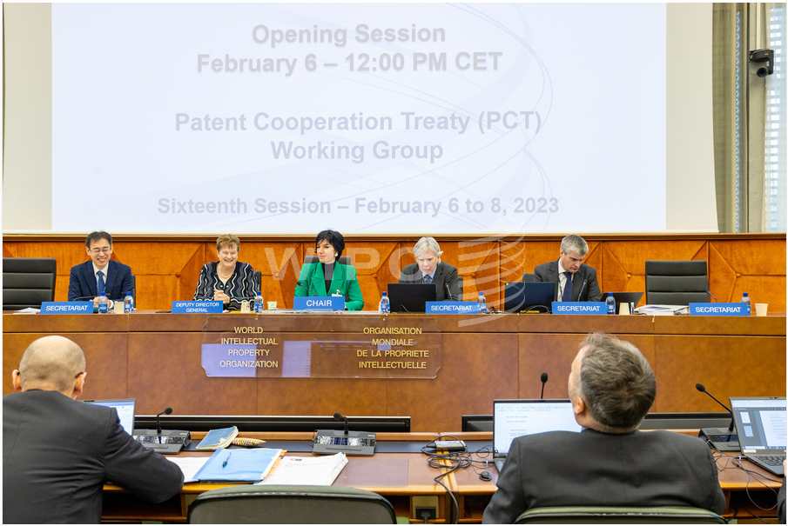
Future developments
Proposal of the PCT Working Group to the PCT Assembly meeting in July 2023 to amend Rule 26 to clarify the procedure for (rare cases of) “mixed-language applications”
  Background: generally, description and claims must be in one and the same language, as a condition for an international filing date (Article 11(1)(i), Rules 12.1(a) and 20.1(c))
  Where description and claims are not in the same language or parts of description/claims are filed in a language different from the remainder of the element, but the languages concerned are languages accepted by the RO, the proposed amendments provide for an invitation/correction procedure
  Where the languages concerned are not accepted by the RO, the application is transmitted to RO/IB under Rule 19.4 (current procedure remains)

Slide 128
Best means of communication with IB
For submissions to RO/IB or IB:
  Use ePCT
  In the event that the service is not available, uploaded through the “Contingency Upload Service” (see https://pct.wipo.int/ePCTExternal/pages/UploadDocument.xhtml)
  No fax

Slide 129
Where to get help

Slide 130

Where to get help
General questions about the PCT
PCT Information Service +41 22 338 83 38
      pct.infoline@wipo.int
Questions about ePCT:
eServices Help Desk +41 22 338 95 23
      pct.eservices@wipo.int
Contact the Speaker:
Eva Schumm +41 22 338 93 93
eva.schumm@wipo.int

