Slide 1

Classification of Goods and Services
Liina Maks
EUIPO

Slide 2
1) Classification
Legal basis – clarity and precision
Class headings
Not acceptable terms
Harmonised Database (HDB)
2) Brief introduction to AI within EUIPO
EUIPO’s vision
AI and classification
Benefits for users
When?

Slide 3

LEGAL BASIS
Article 33(2) EUTMR:
The goods and services for which the protection of the trade mark is sought shall be identified by the applicant with sufficient clarity and precision to enable the competent authorities and economic operators, on that sole basis, to determine the extent of the protection sought.

Slide 4
CLASS HEADINGS
Article 33(3) EUTMR:
For the purposes of paragraph 2, the general indications included in the class headings of the Nice Classification or other general terms may be used, provided that they comply with the requisite standards of clarity and precision set out in this Article.

Slide 5
CLASS HEADINGS
C-307/10 IP TRANSLATOR
Common Communication on the Acceptability of Classification Terms and the General Indications of the Nice Class Headings (CP1)
Notes:
IP Translator – June 2012

Slide 6

CLASS HEADINGS
12th edition of Nice Classification, Version 2025
Unacceptable class headings:
Class 7 Machines, machine tools, power-operated tools
Class 37 Installation and repair services
Class 40 Treatment of materials
Notes:
13th edition 01.01.2026

Slide 7
NOT ACCEPTABLE TERMS (Goods)
NOT ACCEPTABLE:
Class 9 Electronic apparatus and instruments
Class 9 Robots
Class 9 Virtual goods
Gift articles; souvenirs; housewares; hobby articles; gadgets etc

Slide 8

NOT ACCEPTABLE TERMS (Goods)
Class 9 Electronic apparatus and instruments, including GPS apparatus
Class 9 Electronic apparatus and instruments, namely GPS apparatus

Slide 9

NOT ACCEPTABLE TERMS (Goods)
Class 9 Robots
Acceptable terms:
Class 7: Industrial robots
Class 9: Humanoid robots with artificial intelligence for use in scientific research
Class 10: Surgical robots

Slide 10

NOT ACCEPTABLE TERMS (Goods)
Class 9: Virtual goods
Acceptable terms:
Class 9 Downloadable virtual clothing
Class 9 Virtual goods, namely downloadable music files

Slide 11
NOT ACCEPTABLE TERMS (Services)
NOT ACCEPTABLE:
Class 35 Retail services with souvenirs
Class 35 Retail services connected with the sale of legal services
Class 40 Manufacturing services
Class 44 Wellness services
Class 45 Humanitarian services
Association services; Reservation services; Providing virtual environment etc.
Notes:
However, as regards retail services or similar services in Class 35 relating to the sale of goods, such as wholesale services, mail order services and e-commerce services, the Office applies the judgment of 07/07/2005, C‑418/02, Praktiker, EU:C:2005:425: the term retail services is only acceptable where the type of goods or services to be sold or brought together for the benefit of others is indicated with sufficient clarity and precision (see paragraph 4.3). The term retail services of a supermarket and, by extension, retail services of a department store and similar terms are not acceptable as the goods to be sold are not defined (01/12/2016, T‑775/15, Ferli, EU:T:2016:699).
As regards ‘retail of services’ (i.e. services that consist of the bringing together, for the benefit of others, of a variety of services, enabling consumers to conveniently compare and purchase those services), the Court has held that these must also be worded with sufficient clarity and precision to allow the competent authorities and other economic operators to know what services the applicant intends to bring together (10/07/2014, C‑420/13, Netto Marken Discount, EU:C:2014:2069).

Slide 12
ACCEPTABLE TERMS (Services)
ACCEPTABLE TERMS
Class 35 Retail services with souvenirs, namely magnets and pencils
Class 35 The bringing together, for the benefit of others, of a variety of legal services, enabling customers to conveniently compare and purchase those services
Class 40 Manufacturing services of chocolates
Class 44 Wellness services, namely health spa services
Class 45 Humanitarian services, namely providing clothing to needy persons

Slide 13
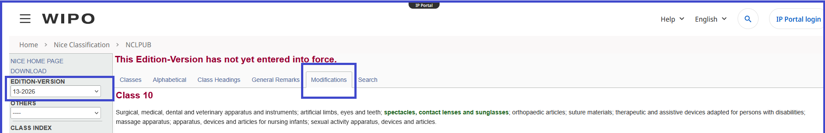
CHANGES AFTER 01.01.2026 – NICE 13th edition
https://nclpub.wipo.int/enfr/?class_number=10&gors=&lang=en&menulang=en&mode=flat&notion=modifications&version=20260101

Slide 14

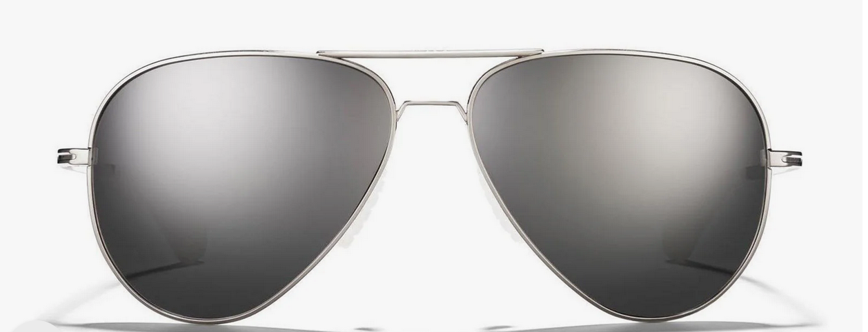
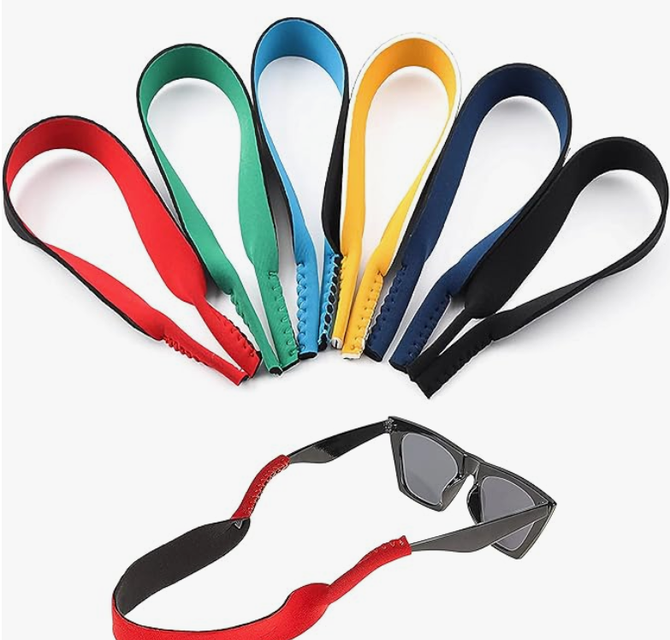
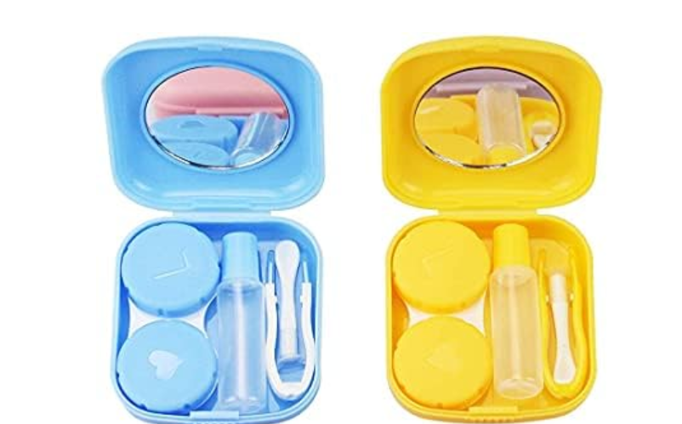
CHANGES AFTER 01.01.2026 – NICE 13th edition
Eyeglasses
Eyeglass chains
Eyeglass cords
Contact lenses
Containers for contact lenses
9 10

Slide 15

CHANGES AFTER 01.01.2026 – NICE 13th edition
Now:
Class 3: essential oils for manufacturing cosmetics
Class 3: essential oils for fragrancing
Class 3: essential oils for aromatherapy
Class 3: essential oils for flavoring food and beverages
As of 01.01.2026:
Class 1: essential oils for manufacturing cosmetics
Class 3: essential oils for fragrancing
Class 5: essential oils for aromatherapy
Class 29: essential oils for flavoring food and beverages

Slide 16

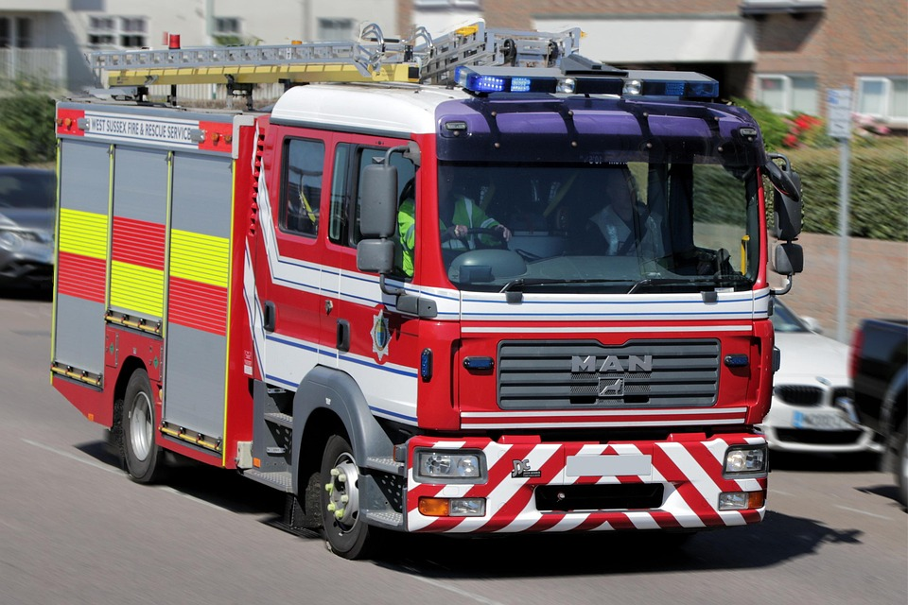
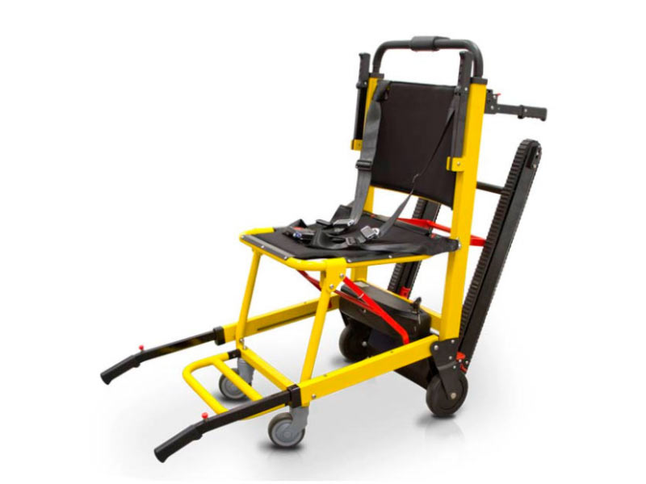
CHANGES AFTER 01.01.2026 – NICE 13th edition
Fire engines
Fire boats
Life-saving rafts
Lifeboats
Evacuation chairs
9 12

Slide 17

HDB – Harmonised Database
TMClass
https://euipo.europa.eu/ec2/
Nice Classification alphabetical list terms
ID List (JPO, KIPO, SAIC, USPTO, EUIPO)
WIPO MGS
Harmonised terms
Available in all EU languages (and more)

Slide 18
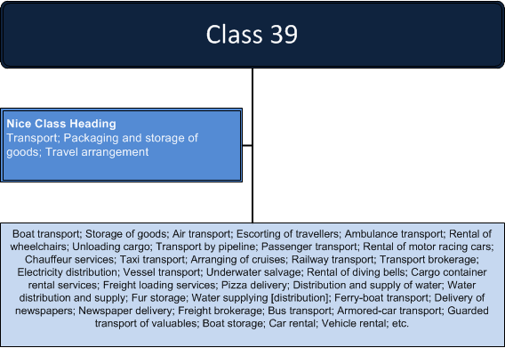
Grouping
Grouping using the class heading

Slide 19
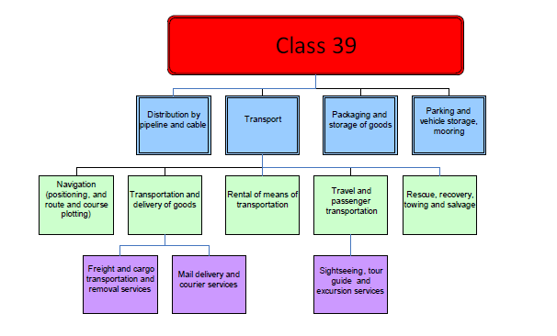
Grouping
Grouping using taxonomy

Slide 20
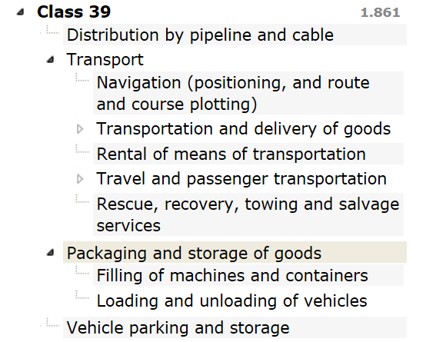
Grouping
Visibility in TMClass

Slide 21

AI and EUIPO
AI & EUIPO

Slide 22
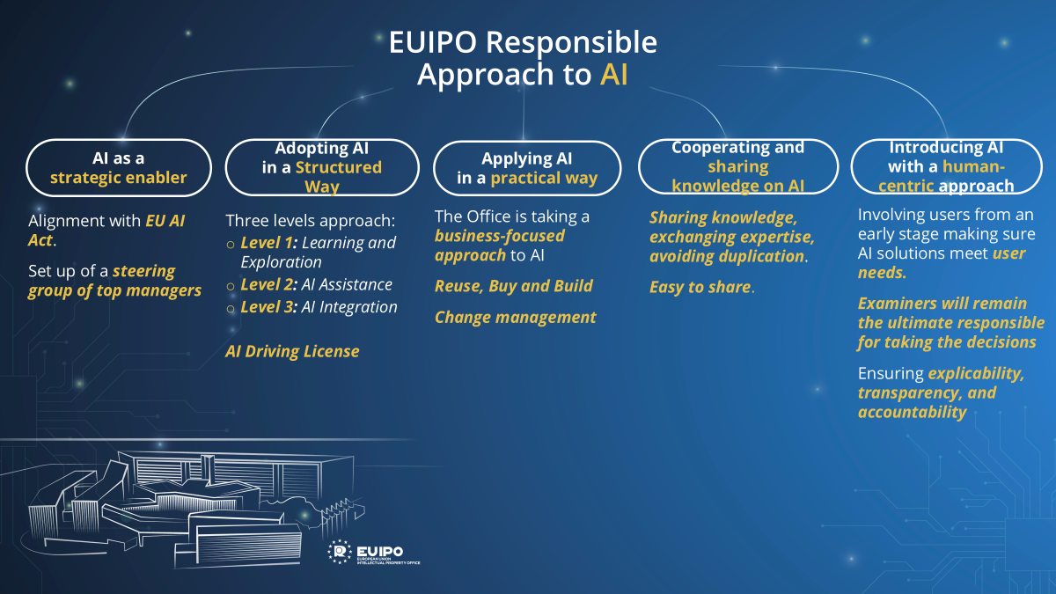
AI and EUIPO

Slide 23







AI and EUIPO
Current usage of AI
Examination
Opposition
TM Applications
TM Registration
Classification
Formalities
Absolute
Ground
Translation
Search
Likelihood of Confusion
Registered
AI Tools/Services
AG Decision Search
G&S Comparison Search
Similar Oppo Decisions
1st Line Chatbot
G&S Suggester
Image Search
A chatbot that answers questions about trademark e-filings, with an option for users to switch to a human agent if the response is unsatisfactory
AI based semantic search to find a suitable match in Harmonised database. It Is available to our users through trademark eFiling applications
Users can utilize image search functionality to find visually similar designs by providing an image as input in TMview, DesignView and eSearch plus.
Service to find EUTMs with similar verbal element ( text and phonetic) and Visual similarities for Absolute ground examination in all EU languages. This service helps absolute ground examiners make informed decisions based on relevant historical cases. The outcome of the tool is presented to examiner for review.
The capability supports relative ground examiners by identifying assessments contained in past decisions that are considered relevant for the particular comparison of goods and services faced during a decision drafting process. The results are presented to the examiner for review, who will be able to proceed by making informed decisions.
The service supports relative grounds examiners during their decision drafting process by identifying office practice (past decisions) considered relevant for concerning confronted signs that present text, phonetic and visual similarities with the ones involved in the case of reference. The outcome of the tool is presented to examiner for review.

Slide 24

AI and Classification
Redefine how G&S are managed by the Office,
by Users and by the EUIPN community.
To be achieved by:
          Leveraging Data and technology
          Transforming User Experience
          Reengineering Working Methods
Notes:
Leveraging data and technology:
Reutilize examination and translations data (legacy)
Develop AI algorithms that learn and automate G&S activities
Add business context to G&S (market sector, industry, economic activity) to support other activities
Use Machine Translation to be more efficient and effective
Transforming User Experience
Predictability by sharing G&S practice data
Revamp TMClass and eFiling G&S Section
Develop G&S Advisor for users to create and improve their list
Co-creation action for users to manage G&S list via User Area
Reengineering working methods:
Collaborative Central Examination (ICE)
Work on content and not on application
No more manual objection and letters
Automatic identification of best candidates for HDB promotion or deletion
Efficient HDB and PreExamined content management

Slide 25

AI and Users
Several benefits for Users:
  Increased predictability thanks to data sharing
  Better guidance thanks to Classification Pre-assessment
  TMclass integration with EUTM filing, Easy Filing and User Area
  Improved search functionalities of TMClass
  More agile mechanism to interact with Examiners

Slide 26

AI and Users
WHEN???
Notes:
The whole plan covers the period of 2025 -2027

Slide 27


Slide 28
Presentation | International Classification of Goods and Services
Status | DRAFT / APPROVED
Approved by owner | -
Authors | LM | Liina Maks
 | -
Contributors | -
 | -
Revision history
Version | Date | Author | Description
0.1 | 13/10/2025 | LM | Adapted from previous presentation
0.1 | DD/MM/YYYY
0.1 | DD/MM/YYYY

