Slide 1
Platform Formalities Officers 2022
Unitary Patent and recent and upcoming changes - EPO
Christina ten Hövel
Key Account Manager/ PA expert Dir.1.5.1.2
21 April 2022

Slide 2
Recent and upcoming changes - EPO
Unitary Patent – overview and transitional measures ahead of entry into force
Oral proceedings by VICO before opposition divisions – update
Observations in opposition proceedings – new practice as of 2 May 2022
Certificate of a European patent – as of 1 April 2022
Central Fee Payment – new functionality as of 1 April 2022
Filing of priority documents – termination of PDX agreements as of 30 June 2022

Slide 3
Unitary Patent
Regulation (EU) 1257/2012 Enhanced cooperation
Regulation (EU) 1260/2012 Translation arrangements
UPC Agreement
OJ EPO 2/2013, p.111 – 142
SC/D 1/15 Decision of Select Committee of 15.12.2015 adopting Rules relating to UPP
SC/D 2/15 Decision of SC of 15.12.2015 adopting Rules relating to Fees for UPP
SC/D 3/15 Decision of SC of 15.12.2015 adopting the Budgetary and Financial Rules
Decision of the President of the European Patent Office dated 22 December 2021 concerning the forthcoming introduction of the Unitary Patent and the possibility of requesting a delay in issuing the decision to grant a European patent in response to a communication under Rule 71(3) EPC (OJ EPO 2022, A4)
Notice from the European Patent Office dated 22 December 2021 concerning the forthcoming introduction of the Unitary Patent and the possibility of requesting a delay in issuing the decision to grant a European patent in response to a communication under Rule 71(3) EPC (OJ EPO 2022, A5)
Notice from the European Patent Office dated 22 December 2021 concerning the forthcoming introduction of the Unitary Patent and the possibility to file early requests for unitary effect (OJ EPO 2022, A6)

Slide 4
Legal basis: Unified Patent Court Agreement (UPCA)
The UPC Agreement was signed on 19 February 2013 by 25 of the participating member states (not by Poland)
It will enter into force on the 1st day of the 4th month from the deposit of the 13th instrument of ratification or accession, including France, Germany and *Italy
The deposit of the instrument of ratification of Germany is the only outstanding requirement for the entry into force
*(after the withdrawal of the UK)

Slide 5
Introduction: Unitary Patent overview
The “Unitary Patent” is a European patent with unitary effect
It has unitary character, provides uniform protection and has equal effect in all participating member states
A European patent will benefit from the unitary effect at the request of the proprietor after grant: post-grant attribution of unitary effect
The EPC grant procedure remains unchanged!
Notes:
5

Slide 6
Patent grant process and unitary effect
Appeal
proceedings
European
patent
application
Refusal or
withdrawal
of application
Limitation
Revocation
Opposition
proceedings
European patent with
unitary effect
in the territories
of the participating
EU member states
Filing and
formalities
examination
Search report
with preliminary
opinion on
patentability
Substantive
examination
Grant of
European
patent
Request of
the patent
proprietor
The European patent is deemed not to have taken effect as a national patent in the participating EU Member States
Notes:
-

Slide 7
The Unitary Patent: Procedure
Unitary patent protection
is a post-grant procedure
is an alternative route next to validation with national offices
must be requested within 1 month from the date of publication of the mention of the grant
It is not an EPC procedure, but governed by EU regulations and secondary legislation established by the Select Committee
It is elegible for European patents only!

Slide 8
The Unitary Patent and the Patent grant process
The current patent grant procedure remains unchanged, including opposition, limitation and revocation
A revocation of the underlying European patent in opposition / revocation procedure, its limitation or maintenance in amended form takes effect for Unitary patent protection to the same extent
The boards of appeal remain responsible for appeals in the EPC procedures

Slide 9
The Unitary Patent: concept
The Unitary Patent will co-exist with national patents and with classic European patents
Various combinations of classic European patent and European patent with a Unitary protection:
a Unitary Patent for the 25 participating member states (EU) possibly together with
a classic European patent taking effect in one or more EPC Contracting States, such as for instance UK, CH, TR, NO
No double protection!

Slide 10
Tasks and responsibilities of the EPO
Centralised post-grant administration by EPO:
Requests for unitary effect
Register for Unitary patent protection
Receipt/registering statements on licences of rights
Collecting/re-distributing post-grant renewal fees
Receipt and publication of translations during transitional period
Administration of compensation scheme for translation costs
Supported by implementing rules, new and integrated IT systems

Slide 11
Registration of Unitary effect
The patent proprietor has to file the request for unitary effect with the EPO:
in writing,
in the language of proceedings,
no later than one month after the mention of the grant is published in the European Patent Bulletin.
The use of EPO form 7000 is strongly recommended
The request can be filed electronically (Online Filing, Online Filing 2.0, Web-form filing), by mail, fax or in person

Slide 12
Registration of Unitary effect
Unitary effect can only be requested for European patents which were granted:
with the same set of claims
in respect of all the participating member states
translations only have to be filed during a transitional period of 6 years (which may be extended up to a maximum of 12 years)
non-observance of time limit and/or correction of deficiencies:
legal remedies, such as re-establishment of rights available

Slide 13
Translation requirements
During the transitional period:
Where the language of proceedings at the EPO is French or German, the patent proprietor will have to provide a translation of the European patent into English
Where the language of proceedings at the EPO is English, the patent proprietor will have to provide a translation of the European patent into one of the official languages of the European Union

Slide 14
Translation requirements and compensation scheme
Build on EPO language regime (Art. 14(6) EPC)
The translations are for information purposes only
According to Council Regulation (EU) No 1260/2012 , the translations should not be carried out by automated means
Compensation scheme for SME’s if the European patent application was filed in an official EU language that is not an EPO language

Slide 15
Responsibility of Unified Patent Court (UPC)
Exclusive jurisdiction for litigation relating to European patents (unless opted-out) and European patents with unitary effect (opt-out not possible)
Actions concerning decisions of the European Patent Office in carrying out the tasks referred to in Article 9 of Regulation (EU) No 1257/2012 (Appeals against negative decisions taken with regards to unitary effect are to be lodged with the UPC)
The opt-out is to be registered with the UPC!

Slide 16
Fees, lapse
Fees:
The request is free of charge
Post-grant renewal fees are to be paid to the EPO
The amounts and fee codes differ from the pre-grant renewal fees
The due date and the grace period are calculated in the same way as under the EPC provisions
Re-establishments of rights is available
Lapse:
20 years after the date of filing of the European patent application
if renewal fee and, if applicable, additional fee are not paid in due time

Slide 17
Renewal fees - amounts
2nd year | 35 EUR | 11th year | 1 460 EUR
3rd year | 105 EUR | 12th year | 1 775 EUR
4th year | 145 EUR | 13th year | 2 105 EUR
5th year | 315 EUR | 14th year | 2 455 EUR
6th year | 475 EUR | 15th year | 2 830 EUR
7th year | 630 EUR | 16th year | 3 240 EUR
8th year | 815 EUR | 17th year | 3 640 EUR
9th year | 990 EUR | 18th year | 4 055 EUR
10th year | 1 175 EUR | 19th year | 4 455 EUR
 |  | 20th year | 4 855 EUR
Fee codes: | 732-750

Slide 18
Costs
Renewal fees set at a level equivalent to the combined renewal fees of the top four countries among the participating Member States at the time the fee level was adopted*
The total fees for the first ten years ‒ which is the average lifetime of a patent ‒ amount to less than EUR 5 000
Moreover, patent proprietors who file a statement on a licence of right with the EPO can obtain a 15% reduction on the renewal fees
*DE, FR, UK, NL

Slide 19
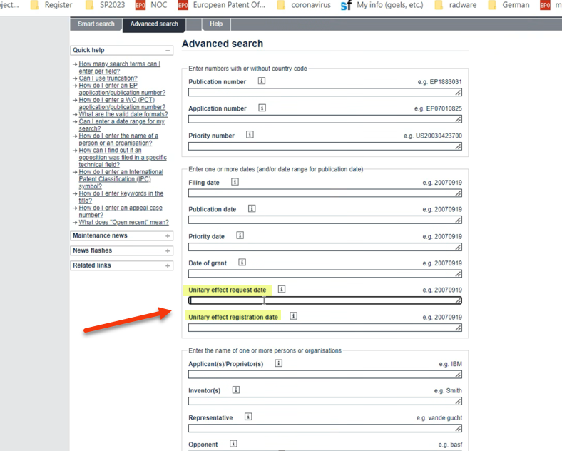
Unitary Patent information in the European patent register

Slide 20
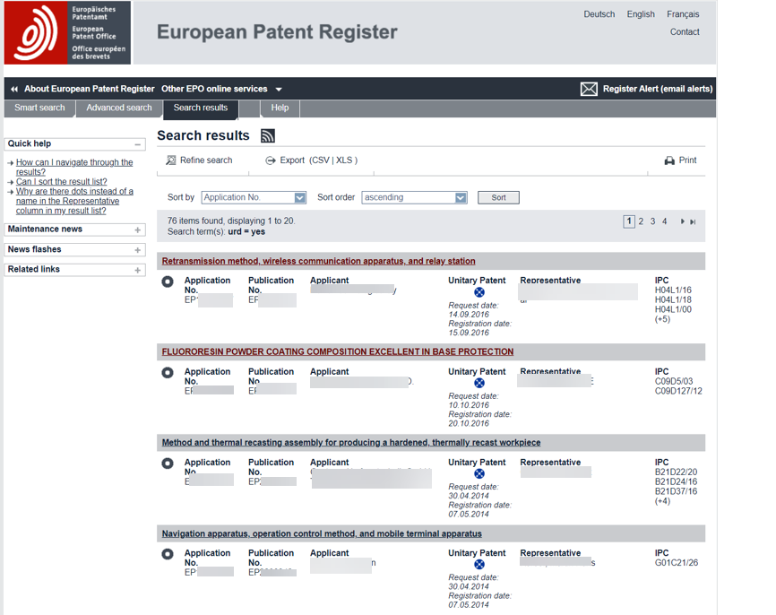
Unitary Patent information in the European patent register

Slide 21
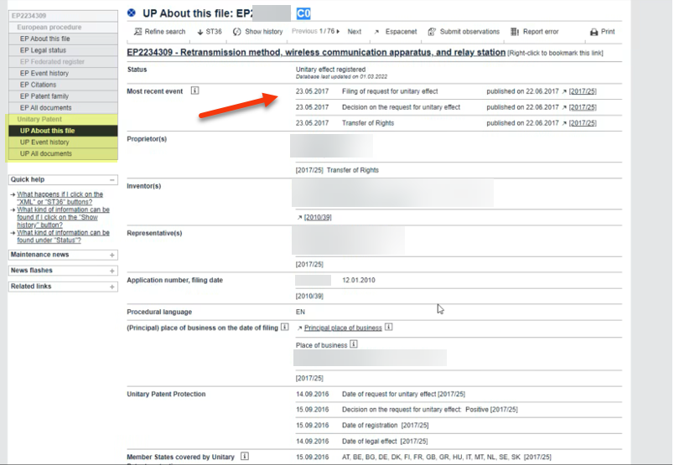
Unitary Patent information in the European patent register

Slide 22
Transitional measures ahead of the entry into force
The deposit by Germany of its ratification instrument of the UPCA will formally trigger the entry into force of the UPCA
To support applicants in an early uptake of the Unitary Patent, the EPO will introduce the following transitional measures as from the date of deposit by Germany (to be announced):
Request a delay in issuing the decision to grant a European patent in response to a communication under Rule 71(3) EPC (OJ EPO 2022, A4, A5)
File an early request for unitary effect (OJ EPO 2022, A6)

Slide 23
Request a delay in issuing the decision to grant a European patent in response to a communication under Rule 71(3) EPC
Entry into force as from the date the Federal Republic of Germany deposits its instrument of ratification of the Agreement on a Unified Patent Court
The EPO shall communicate this date on the EPO's website
Upon request the EPO will delay issuing its decision to grant a European patent, so that the mention of the grant in the European Patent Bulletin will be published on or immediately after the date of entry into force of the Agreement on a Unified Patent Court

Slide 24
Request a delay in issuing the decision to grant a European patent in response to a communication under Rule 71(3) EPC
The request can be validly filed only if the applicant has been informed of the text intended for grant by a communication under Rule 71(3) EPC but has not yet approved that text
Any request not meeting the requirements or filed before the entry into force of this date shall be deemed not to have been filed
The EPO will provide a dedicated request form (EPO form 2025) for this purpose

Slide 25
Early request for unitary effect
Entry into force as from the date the Federal Republic of Germany deposits its instrument of ratification of the Agreement on a Unified Patent Court
The EPO shall communicate this date on the EPO's website
Early requests for unitary effect may only be filed for European patent applications in respect of which a communication under Rule 71(3) EPC has been despatched

Slide 26
Oral proceedings by VICO before opposition divisions – update
Decision of the President of the European Patent Office dated 23 November 2021 concerning a further extension of the pilot project for oral proceedings by videoconference before opposition divisions; Decision of the President of the European Patent Office dated 14 May 2021 concerning the further extension of the pilot project for oral proceedings by videoconference before opposition divisions, OJ EPO 2021, A41; Decision of the President of the European Patent Office dated 14 April 2020 concerning the pilot project for oral proceedings by VICO before ODs, OJ EPO 2020, A41); Notice from the European Patent Office dated 14 April 2020 concerning the pilot project for oral proceedings by VICO before ODs OJ EPO 2020, A42; Decision of the President of the European Patent Office dated 23 November 2021 concerning a further extension of the pilot project for oral proceedings by videoconference before opposition divisions, OJ EPO 2021, A93;
Decision of the President of the European Patent Office dated 4 April 2022 concerning a further extension of the pilot project for oral proceedings by videoconference before opposition divisions

Slide 27
Oral proceedings in opposition by videoconference
The pilot project for oral proceedings by videoconference before opposition divisions, as set out in the decision of the President of the European Patent Office dated 10 November 2020 concerning the modification and extension of the pilot project for oral proceedings by videoconference before opposition divisions, is further extended to run until 31 December 2022

Slide 28
Taking of evidence by VICO
as of 1 January 2021
The EPO indicates whether the taking of evidence will take place by VICO, and the witness to be heard is informed accordingly (new Rule 117, 118(2)(a) EPC)
The party, witness or expert to be heard may request to be heard by VICO even if the oral proceedings are held on the EPO's premises (new Rule 118(2)(c) EPC)
Inspection of an object may also be ordered and carried out in the form of VICO

Slide 29
Test call - ZOOM
Users are strongly advised to perform a test call in good time prior to the date of the oral proceedings, i.e. at least 10 working days in advance
The EPO offers the possibility for test calls on Mondays to Fridays (except days on closed days) from 13:00 to 16:00 hours CET
A test call can be arranged by contacting the EPO Serviceline on Mondays to Fridays (except closed days) from 07:30 to 18:00 hours CET by telephone +31 70 340 4444 or by email (serviceline@epo.org)

Slide 30
New features
Digital whiteboards for use by attorneys to sketch diagrams - as on a traditional flipchart - to support their arguments
Additional audio channels will be made available if requested in advance by the parties concerned to facilitate interpretation into admissible non-EPO languages
Digital deliberation or breakout rooms will allow parties to confer in private
The EPO will continue to update and broaden its training portfolio to help representatives familiarise themselves with these new features

Slide 31
Observations in opposition proceedings
new practice as of 02.05.2022
Notice from the European Patent Office dated 9 March 2022 about access to observations made by parties to opposition proceedings and by third parties, OJ EPO 2022, A28

Slide 32
Observations in opposition procedure
The current practice applied to patent and non-patent literature is extended to all annexes filed during opposition proceedings
Copies of any documents annexed to notices of opposition or to letters which are available for inspection and for download in the European Patent Register will no longer be automatically transmitted by the EPO
The EPO will, however, continue to communicate notices of opposition and all letters to the other parties for information

Slide 33
Observations in opposition procedure
The EPO will still communicate documents which are not available for inspection in the European Patent Register (e.g. models or videos) or which are not easily legible (e.g. colour documents)
Paper copies of documents in the Register will continue to be made available to parties to opposition proceedings free of charge on request
Parties attending oral proceedings are advised to check the electronic file via the European Patent Register in advance of the proceedings to ensure that they are in possession of all the relevant documents

Slide 34
Observations in opposition procedure
This practice will also be extended to third-party observations
The EPO will continue to communicate such observations filed anytime during pending proceedings to all the parties
Their annexes will be made available for inspection and for download in the European Patent Register
Applicable to submissions made on or after 2 May 2022!

Slide 35
Certificate of a European patent
as of 01.04.2022
Decision of the President of the European Patent Office dated 17 December 2021 concerning the content, form and means of communication of the certificate for a European patent, OJ EPO 2021, A94
Notice from the European Patent Office dated 17 December 2021 concerning communication of the certificate for a European patent, OJ EPO 2021, A95

Slide 36
Introduction of a digital grant certificate
The certificate issued for a European patent as granted or amended or limited will be communicated to the proprietor(s) or their representative
Recipients with an activated Mailbox will receive it as a digital file for download from the Mailbox
No additional paper copy will be sent
Recipients without an activated Mailbox will receive it on paper and delivered by postal services.
Certified copies of the certificate with the specification annexed will be issued in paper format to the proprietor upon request and payment of an administrative fee
Applicable to certificates issued as from 1 April 2022!

Slide 37
Introduction of a digital grant certificate
The electronically issued certificate for a European patent is a digital colour document
The Mailbox user can store and forward the certificate digitally, or print it in colour
In parallel with the transition to an electronic certificate the EPO has refreshed the layout and content of the certificate
The layout of the digital and the paper version of the certificate are identical

Slide 38
New layout of the grant certificate

Slide 39
Central Fee Payment
new functionality as of 01.04.2022
Notice from the European Patent Office dated 2 March 2022 concerning the extension of the functionalities of Central Fee Payment, OJ EPO 2022, A26

Slide 40
One centralised payment service - goals
As-is situation
Multiple payment services and functionalities to pay patent fees to the EPO:
Bank transfer
Credit card via the Credit card and refund claim service on EPO website
Deposit account. Submission of debit order via OLF/OLF2.0/OFP
To-be situation
One centralised payment service based on the current credit card and refund claim service using SAP e-commerce:
Bank transfer/Credit card/Deposit account/…
Replace all existing services by one centralised payment service:
With improved functionalities
Directly accessible via EPO website
Accessible via the future filing services to file and pay in one go

Slide 41
Fee Payment - current options
via the “pay fees” sections in the electronic filing tools (OLF, OLF 2.0)
option will remain
Online Fee Payment (for payment from deposit accounts, automatic debit orders, bulk payments)
the tool will be decommissioned in September 2022
Central Fee Payment (credit card payment, facilitating bank transfers, claiming refunds, payment from deposit accounts, bulk payments)
the tool will be further developed (deferred payment, automatic debit orders,…)

Slide 42
Central Fee Payment - functionalities
Facilitating payments by bank transfer, credit card and from deposit account
Batch upload functionality in csv. and xml format
Validation functionality
Display of fees due and time limits
Deposit account management

Slide 43
Central Fee Payment (CFP) - changes April 2022
Balance overview, transactions, pending debit orders, statements
April 2022
Deposit account management in CFP
Improved functionalities
New: Improved overview and selection/filtering possibilities
New: Payment confirmations automatically created and available at any time within CFP
New: Self-service creation of statements for a given period

Slide 44
Central Fee Payment - update on changes 2022
April 2022:
Deposit account management
September 2022:
Automatic debiting management and
other functionalities
Decommissioning of Online Fee Payment
Central Fee Payment in place
Online seminars and presentations planned to assist users with the transition to Central Fee Payment

Slide 45
Central Fee Payment
Central Fee Payment can be accessed either via a simple registration process with user name (email address) and password or
using an EPO smart card
For making payments via deposit account, users must access Central Fee Payment with their EPO smart card as only then will the option for paying via deposit account be available
Batch payments for multiple applications are possible by uploading a file in csv or xml format

Slide 46
Central Fee Payment - access

Slide 47
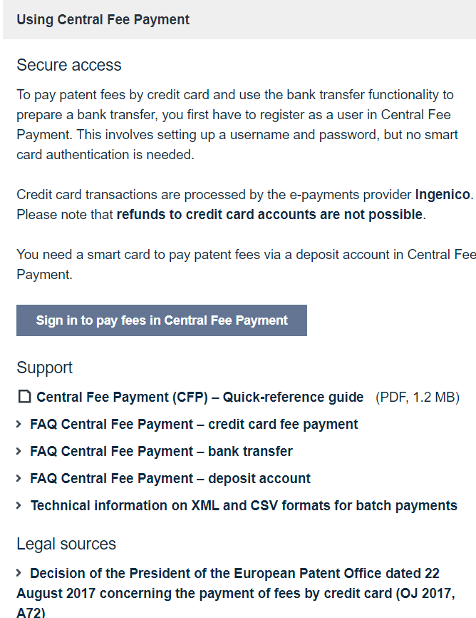
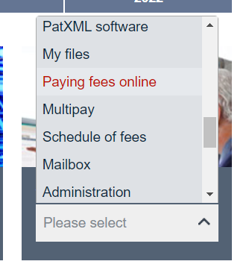
Central Fee Payment - access

Slide 48
Central Fee Payment - webinars
Open for registration:
2 dates per language:
English: 10.05. and 18.5.2022
German: 12.05. and 17.5.2022
French: 24.05. and 01.6.2022

Slide 49
Filing of priority documents
Decision of the President of the European Patent Office dated 13 November 2021 on the filing of priority documents, OJ EPO 2021, A83
Notice from the European Patent Office dated 13 November 2021 concerning priority document exchange between the European Patent Office and the United States Patent and Trademark Office, the Korean Intellectual Property Office and the China National Intellectual Property Administration, OJ EPO 2021, A84
Notice from the European Patent Office dated 31 March 2020 concerning priority document exchange between the European Patent Office and the Japan Patent Office, OJ EPO 2020, A58

Slide 50
Inclusion of copy of previously filed application
Inclusion a copy of the previous application from which priority is claimed if the previous application is:
A European patent application
An international application filed with the EPO as receiving Office under the PCT
or:
At the request of the applicant, via the WIPO Digital Access Service using the indicated access code

Slide 51
Termination of Priority Document Exchanges (PDX) Agreements
The PDX Agreements between the EPO and the United States Patent and Trademark Office (USPTO), the Korean Intellectual Property Office (KIPO) and the China National Intellectual Property Administration (CNIPA) will terminate as of 30.06.2023
The four offices will use DAS as the sole tool for exchanging priority documents electronically
With the termination of the PDX Agreements, the EPO will no longer include a US, Korean or Chinese priority document in the file automatically in cases where it cannot be retrieved via DAS or where the applicant does not request retrieval via DAS

Slide 52
Termination of Priority Document Exchanges (PDX) Agreements
This applies to European patent applications filed with the EPO on or after 1 January 2022 and Euro-PCT applications entering the European phase on or after that date that claim priority from a US, Korean or Chinese patent or utility model application
Additionally, it applies to any European patent applications or Euro-PCT applications claiming priority from a US, Korean or Chinese patent or utility model application for which the required priority document could not be included in the file of the application by 30 June 2023
The PDX Agreement with the Japan Patent Office (JPO) has terminated as of 31 December 2021 already

Slide 53
Thank you for your attention!

